Slide 1
How well do we understand ourselves and our colleagues?
Maggie - Peace and Conflict Consultant

Slide 2
Understanding Personal Differences and Similarities that affect OUR Interpersonal Relationships & work
Maggie - Peace and Conflict Consultant
OBJECTIVES
Understanding our strengths and weaknesses
Minimizing/ address distractive intra-personal conflicts
Owning and enhancing personal strengths
Working on personal weaknesses/ challenges
Understanding other people’s strengths and weaknesses
Minimize/ manage distractive interpersonal conflicts arising from our differences
Acknowleding/ appreciating and boosting other people’s strengths/ assets
Build each other OR

Slide 3
MBTI: Myer Briggs Type Indicator (Personalities)
Maggie - Peace and Conflict Consultant
Favourite world (Introversion or Extroversion)
Information consumption (Intuition or Sensing)
Decision Making (Feeling or Thinking)
Structure/ organization (Judging or Perceiving)

Slide 4
.
Maggie - Peace and Conflict Consultant
DISCLAIMER
Not Absolutes- A person’s personality could be anywhere on the scale
A person can have any of the combinations in the different broad categories.
Not a ticket out of your JD
I only have 45 minutes; I will rush through but will provide notes on www.konflikt-transformation.com

Slide 5
.
Maggie - Peace and Conflict Consultant
DISCLAIMER
DISCLAIMER: MBTI isn’t the only theory that tries to explain personality: Other are:
Biological Theories
Psychoanalytical
Sociological

Slide 6
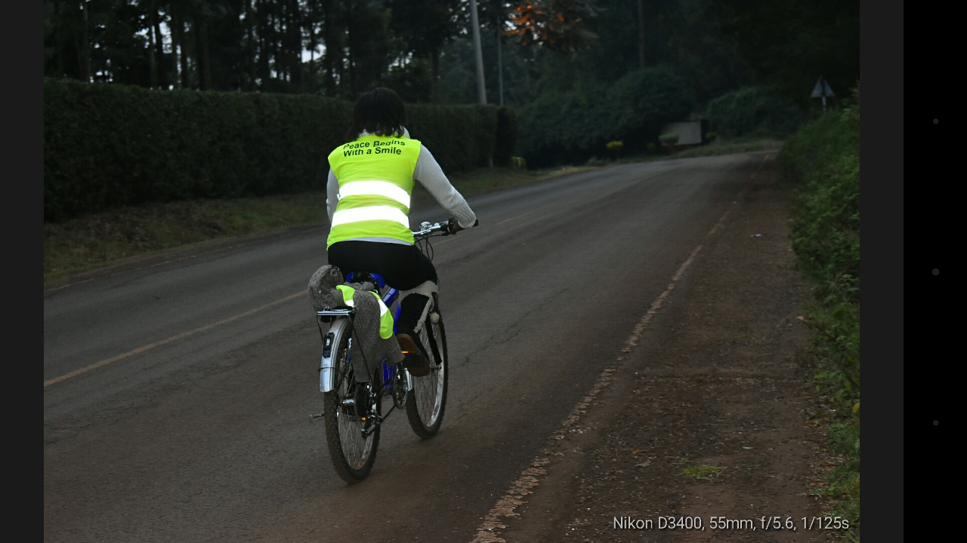
Different Personalities, different Preferences
Maggie - Peace and Conflict Consultant

Slide 7
Favourite World/ Source of Energy
Maggie - Peace and Conflict Consultant
Introversion (I)
Extroversion (E)
Ingest fact, interpret, add meaning
‘Gut Feeling’
Outwards
Vast socialization
More contacts
Less deep connections

Slide 8
Information Consumption
Maggie - Peace and Conflict Consultant
INtuition (N)
Sensing (S)
Inwards
Concentrated socialization
Few contacts
Deeper connections
Basic facts, as it is (using 5 senses)

Slide 9
Decisions: Decision-Making Processes
Maggie - Peace and Conflict Consultant
Feeling (F)
Thinking (T)
Emotions,
In the heat of the moment
Intensity of elicited emotion
Fast Decisions
Not always factually-based
Logic & Consistency
Procedural
Might take long

Slide 10
Maggie - Peace and Conflict Consultant

Slide 11
Structure/ Organization (dealing with the external world)
Maggie - Peace and Conflict Consultant
Judging (J)
Perceiving (P)
Prefer to get things done (more/ instantly action-oriented)
Strict organization
Stay open to new information (a bit abstract
‘organized’

Slide 12
Exercise
Maggie - Peace and Conflict Consultant
Procedure
Questions
4 groups: Each group picks one broad category
Requirements:
Flipcharts
Marker Pens
Sources of conflicts
Between Similar Types e.g Introverts and introverts, or extroverts and extroverts)
Between different types, e.g (Extroverts Vs. Introverts)
How do you manage conflicts
How do you ‘adjust’ your personality to make life less stressful for others
What do you wish those of the opposite Type (personality) would do (not do) to make your life less-stressful)

